Slide 1
Digital Portfolio
STUDENT NAME: K.Sindhu
REGISTER NO AND NMID:
36324u18063/5D22FE4EE19AC2EA97540B9DEBC5D7F7
DEPARTMENT: Computer Science
COLLEGE: Sree Abiraami arts and science college / Thiruvalluvar University

Slide 2

PROJECT TITLE Digital Portfolio For student

Slide 3


AGENDA
Problem Statement
Project Overview
End Users
Tools and Technologies
Portfolio design and Layout
Features and Functionality
Results and Screenshots
Conclusion
GitHub Link

Slide 4

PROBLEM STATEMENT
Most interviews are happening online nowadays.
A hard copy resume is useful only in face-to-face interviews.
Resume cannot fully show skills, projects, and achievements.
Recruiters want to see real proof of work, not just text.
Need a digital portfolio to present achievements and success clearly.

Slide 5

PROJECT OVERVIEW
Portfolio highlights my learning journey and technical knowledge.
The portfolio helps recruiters and Technical Interviewer easily know my abilities.
It is a digital platform to present myself in a professional way.
This portfolio is created to showcase my skills, projects, and achievements.
Portfolio contain about Me, Skills, Certificate, Project, Contact.

Slide 6

WHO ARE THE END USERS?
Students – to show their learning and achievements.
Job Seekers – to present skills in interviews.
Recruiters / Employers – to check candidate’s ability.
Teachers / Professors – to evaluate student work.
Freelancers – to attract clients with their projects.
Professionals – to build a digital identity

Slide 7
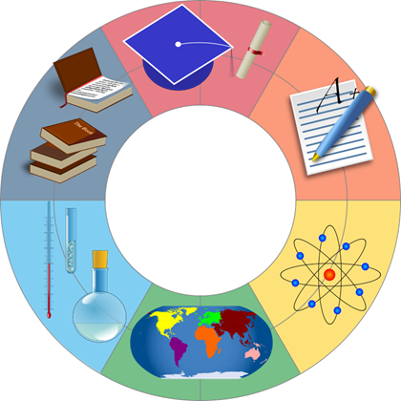
TOOLS AND TECHNIQUES
HTML – for structure.
CSS – for styling.
JavaScript – for interactivity.
CodePen – for development and testing.
Responsive Design – works on laptop and mobile.

Slide 8
POTFOLIO DESIGN AND LAYOUT
Sections- About Me, Skills, Certificate, Project, Contact.
Grid Layout – To arrange sections neatly in rows and columns.
Responsive Design – To adjust for laptop and mobile.
8

Slide 9
FEATURES AND FUNCTIONALITY
Responsive Design – Works on laptop and mobile.
Navigation Menu – Easy movement between sections.
Interactive Elements – Buttons, hover effects, animations.
Project &Certificate – Display Highlight achievements clearly.
Contact Form / Links –Easy way to reach me.
Clean Grid Layout – Organized and professional look

Slide 10
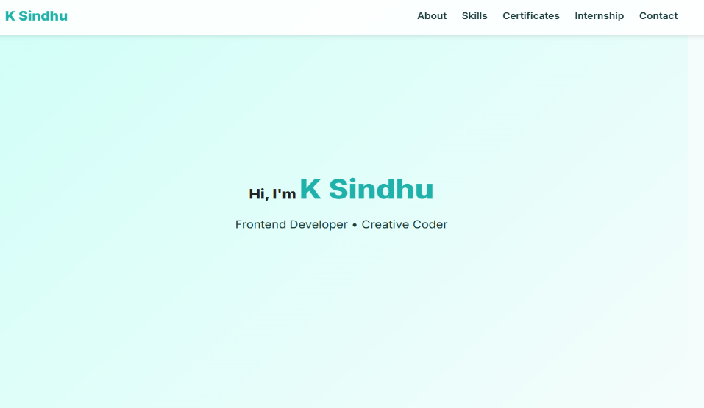
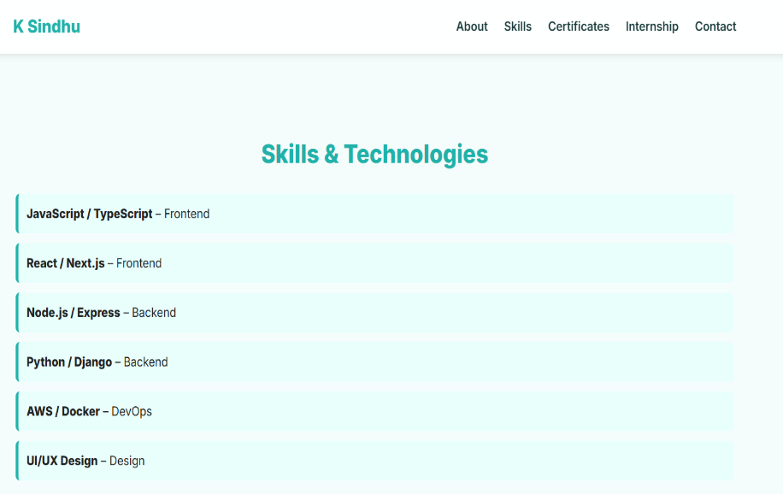
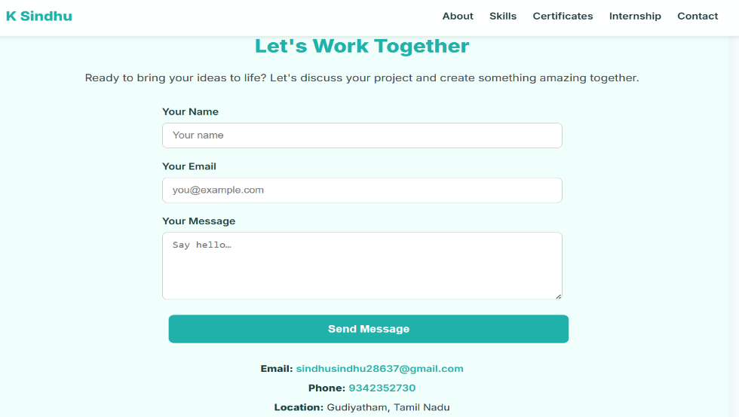

RESULTS AND SCREENSHOTS
10

Slide 11
Links
GitHub Link : https://github.com/sindhu9005?tab=repositories
Portfolio Link : https://sindhu9005.github.io/-sindhu-portfolio/

Slide 12
CONCLUSION
🎯
This portfolio is a digital platform that presents my skills, certificates, and projects in a professional way.
It is built using HTML, CSS, and JavaScript with a responsive design that works on both laptop and mobile.
The portfolio highlights my achievements and supports online interviews, making it easier to showcase my abilities.
It also reflects the importance of digital identity and contributes to society by encouraging innovation in the modern world.
12

